Slide 1

ALGORITHMIC POST-COVD TRADING STRATEGY
Jain, Nitesh
Lakshmanan, Veldurai
Munipalle, Amar
Sooriyakumar, Sinthushan

Slide 2
Executive Summary
Algorithmic post COVID trading strategy
Avoid growth and value traps
Build on new thesis
Longer for lower
Recovery will be stalled
Certain industries will be wiped out
Approach
Computational - unsupervised learning, clustering and classification
Technical – combination of fundamental and technical indicators
Outcome
High conviction 10 stock portfolio
Clearly defined trading thresholds
Aligned with strategy

Slide 3
Strategic Building Blocks
Sector winners and losers created by COVID will PERSIST.
S&P 2020 Returns TO-DATE DRIVEN BY THIN VOLUMES
AVOID TEMPATION OF CHASE ESTABLISHED NAMES

Slide 4
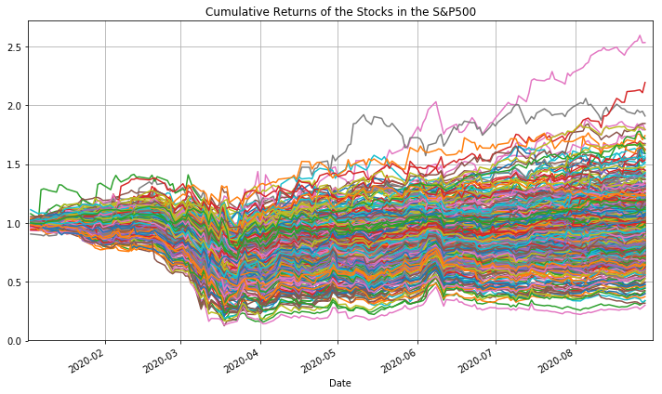
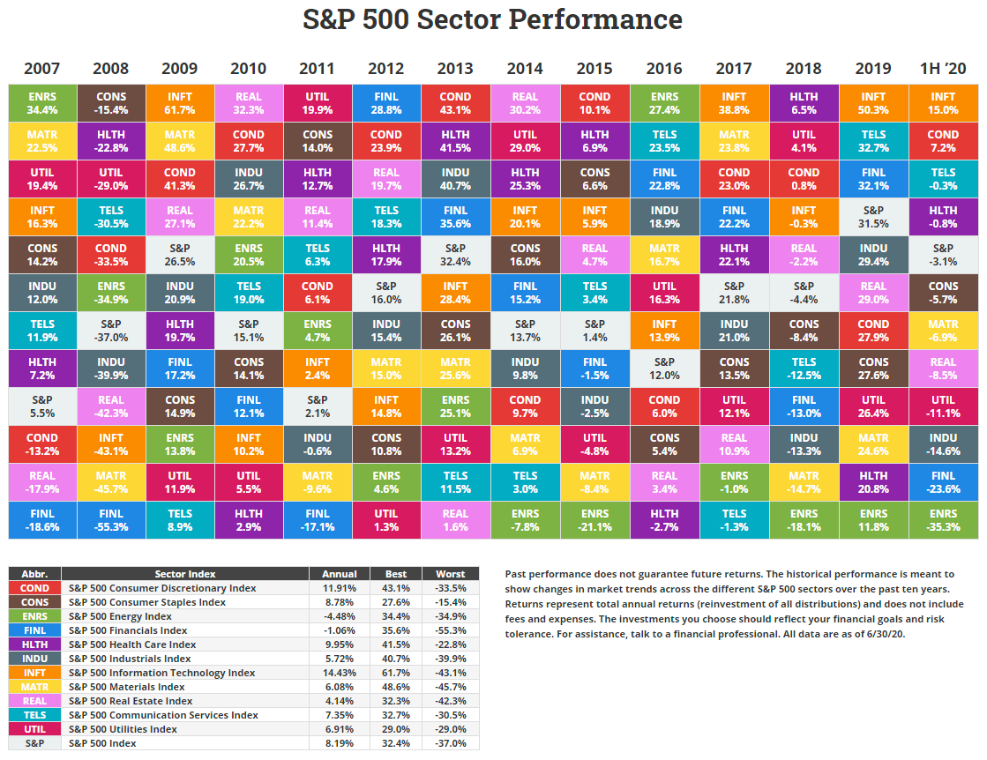
SO FAR IN 2020 - most stocks missing party
Resulting IN SKEWED RETURNS.
Sector winners and losers created by COVID
14 stocks incl. Apple (AAPL), Amazon (AMZN) and UnitedHealth (UNH), generated 1/3rd of market value gain from March 23 low (a/o H1 2020)
For every stock that advanced, 1.7 declined → broad sector inequalities
Massive rotation to mega-tech - perceived ability of weathering uncertainty
Ten most valuable companies - ~30 % of S&P500 capitalization
Under-performance in cyclical sectors like financials and industrials
source: https://novelinvestor.com/sector-performance/; www.forbes.com

Slide 5
OUR APPROACH
AVOID GROWTH TRAPS
AVOID OPTIMISM OF POT VACCINE REBOUND
ELIMINATE BIAS THROUGH SOUND COMPUTATIONAL TECHNIQUES
DATA CLEANING
UNSUPERVISED LEARNING
INITIAL SCREEN (50 stocks)
FACTORS
LABELING / SUPERVISED TRAINING
BUY LIST (10 conviction Stocks)
TRADE $$$

Slide 6
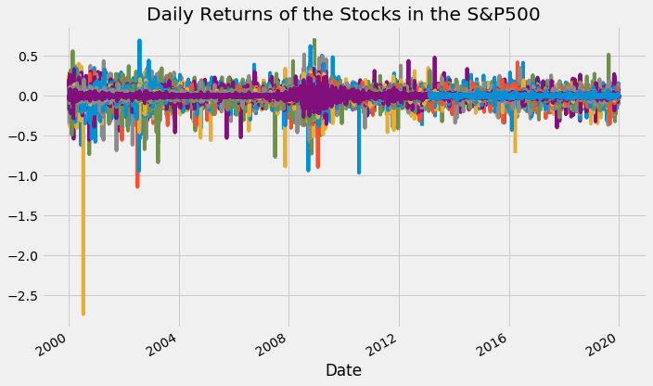
DATA PREPROCESSING
IMPORTING LIBRARIES
yfinance
IMPORTING DATASET
SP500 1Yr & 20Yr
HANDLING MISSING DATA
Drop Nulls
HANDLING CATEGORICAL
N/A
SCALING
Daily Log Returns
Key Learnings:
Few tickers fall off S&P → survivorship bias
Reasonableness check necessary at every level
source: www.medium.com;
https://towardsdatascience.com/stock-market-analytics-with-pca-d1c2318e3f0e

Slide 7
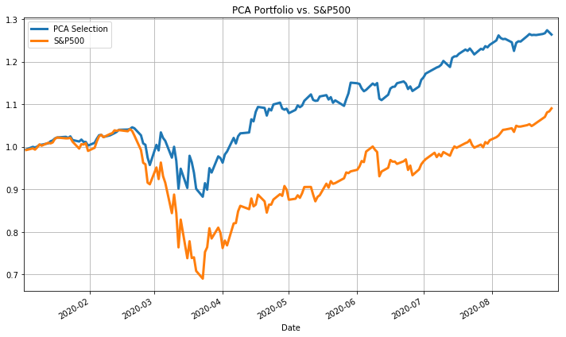
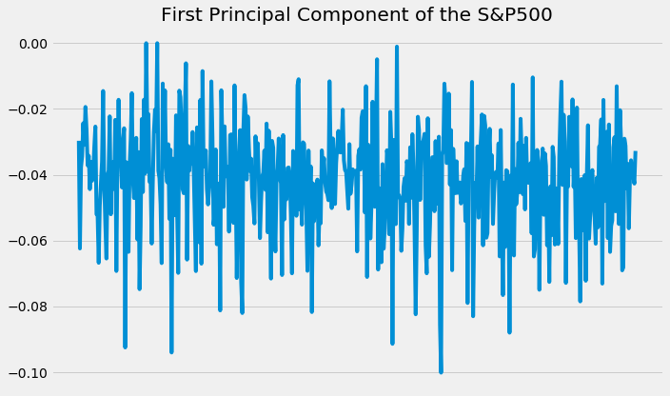
UNSUPERVISED LEARNING - PCA
1. Link with CAPM:
First principal component approximates market factor.
…to extract meaningful signals…
…and converts a noisy time series…

Slide 8
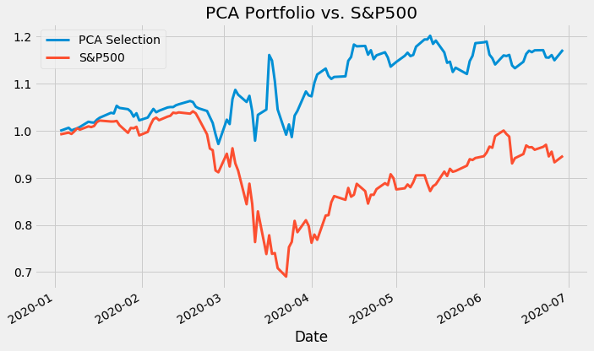
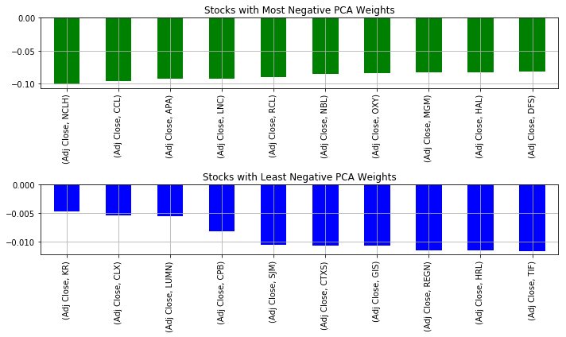
INITIAL SCREEN – THE PCA PORTFOLIO
Key Learnings:
As expected material tracking error between first order PCA and SP500 BUT
Helps us look beyond the obvious names → stocks with least negative PCA weights
I went to my neighborhood supermarket (KR); bought Campbell soup (CPB); chicken nuggets (HRL); cereal (GM); Folgers(SJM) refilled my meds (REGN) and loaded up wipes and TP (CLX)

Slide 9
BRING IT ON – MACHINE LEARNING
Initial Screen
PCA List
Technical Features
Every stock
Daily basis
Fundamental Features
Every Stock
Daily Basis
Labeled Dataset
Fund + Tech
Beat SP500 ?
1 –Yes; 0- No

Slide 10
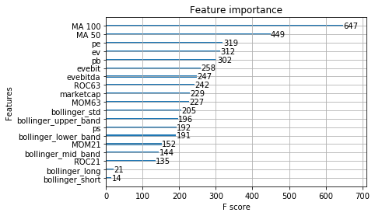
HONEY DO WE HAVE TOO MANY FEATURES?
Feature | Description
Technical | MA, EMA, STOK, STOD, BOL,ROC,MOM
Fundamental | EV/EBIT, MC, P/B, P/E, P/S
XG
Boost
SOME FEATURES DON’T ADD MUCH
And can be dropped without significant loss in predictive power

Slide 11
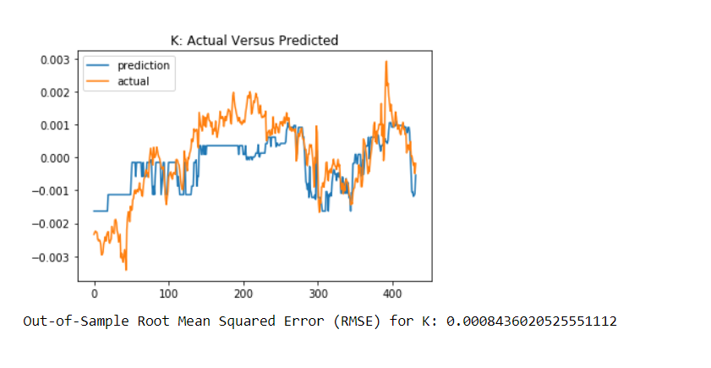
BACK TO MACHINE LEARNING 101
LIBRARIES
QUANDL; sci-kit
DATASET
PCA screen+ features
TRAIN TEST SPLIT
Time Series !
SCALING
MinMax –data not normal
Label Data
Alpha = Stock-SP500
Train
Test
Palette of 3-Month predicted vs. actual returns
Computed for all 50 stocks from PCA screen
PICK TOP 10 HIGH CONVICTION STOCKS WITH BEST PREDICTIVE POWER

Slide 12
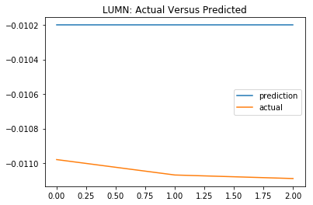
ARE WE HOME ?
TOP 10 LIST
BUT THIS ONE LOOKS WEIRD ?
GLAD WE CAUGHT IT
0 | RMSE
KMB | 0.000627
CL | 0.000702
COST | 0.000715
JNJ | 0.000728
DG | 0.000776
CPB | 0.000816
AKAM | 0.000835
K | 0.000844
LUMN | 0.000846
ED | 0.000884
DESPITE BEST EFFORTS ONE BAD DATA POINT
LUMN PRICE OF ZERO ACTUALLY RESULTED IN A GOOD RMSE
LESSON – VISUALLY INSPECT ALL DATA AND RESULTS
WE COMBED OVER 50 PREDICTION GRAPHS

Slide 13
CHALLENGES AND IMPROVEMENTS
WE HAVE BUILT A GOOD ALGO….
….WHICH WE CAN IMPROVE WITH THE TRADING COMPONENT
TRADE-OFF BETWEEN FINDING PRE_FORMATTED DATA vs. BUILDING GROUND UP
WE BOUGHT QUANDL DATA FOR FACTORS TO FOCUS ON MODEL BUILDING AND NOT DATA CLEANING
PLAYED AROUND WITH A FEW ML MODELS…BEFORE CHOOSING XGBoost
WE ARE AWARE THAT THE MODEL IS ONLY AS GOOD AS THE LAST TRADE
KEY IS TO CONTINOUSLY AUTOMATE AND ENSURE DATA ROBUSTNESS

Slide 14
RECAP
WE SET OUT TO BUY A HIGH CONVICTION PORTFOLIO….
….WITHOUT MAKING BEZOS, NADELLA or MUSK RISK → Growth at a Reasonable Price
WE APPLIED A DIMENSIONALITY REDUCTION ALGORITHM (PCA) TO ACCESS 1st order IMPACTS
…..THIS GAVE US A PORTFOLIO WITH A BIAS TO CONSUMER DURABLES AND SOME VALUE TECH
WE THEN CODED TECHNICAL AND FUNDAMENTAL GROWTH AND VALUE FEATURES TO LABEL ALPHA
….THIS SET US UP NICELY FOR A HIGH BIAS ENSEMBLE LEARNER LIKE XGBoost
WE HAVE TEN STOCK PORTFOLIO WITH HIGH RMSE THAT EVEN VISUALLY PREDICTS PERFOMANCE WELL
….WE WILL CONTINUE TO DEVELOP THE TRADING COMPONENT OF THIS ALGO

Slide 15
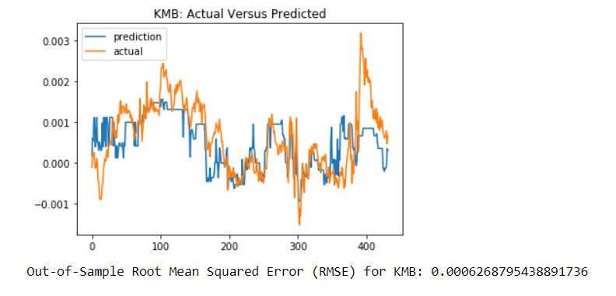
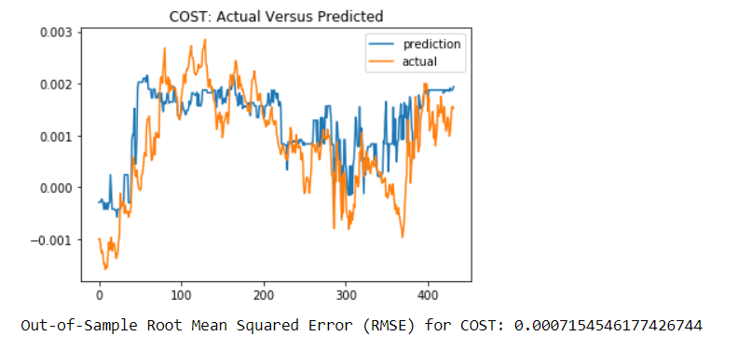
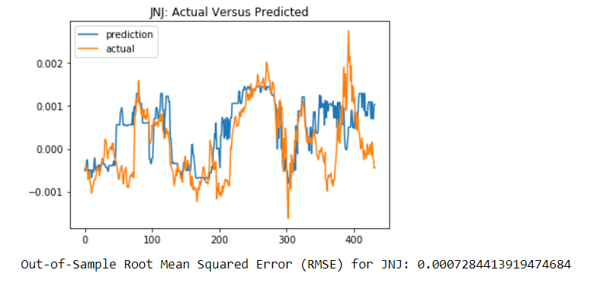
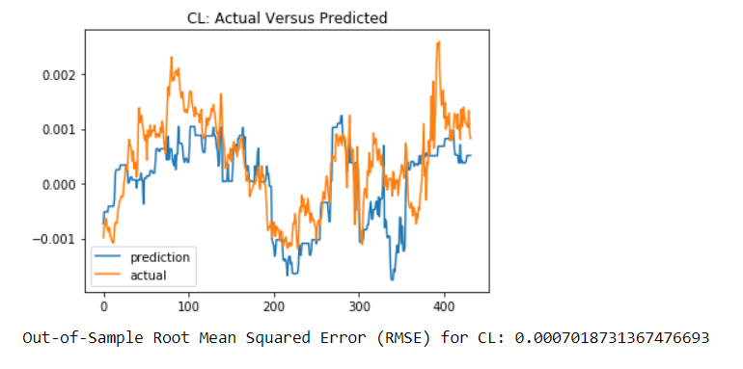
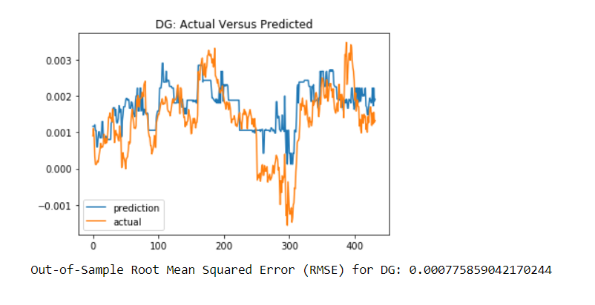
THE REVEAL….
TOOTH-PASTE & TP
COSTCO and Dollar G
Ear buds and Cereal
OUR MODEL DOES WELL WITH STEADY MATURE BUSINESSES! IT’S SOLID BUT NOT FLASHY

